Slide 1
Security Aspects of Container Orchestration
Patrick Deutschmann, 28 June 2019

Slide 2
Image Source: docker.com, accessed 20 June 2019

Slide 3
Distributed?
Scaling?
Communication?
Deployment?
Health?
Image Source: docker.com, accessed 20 June 2019

Slide 4
Image Source: kubernetes.io, accessed 20 June 2019

Slide 5
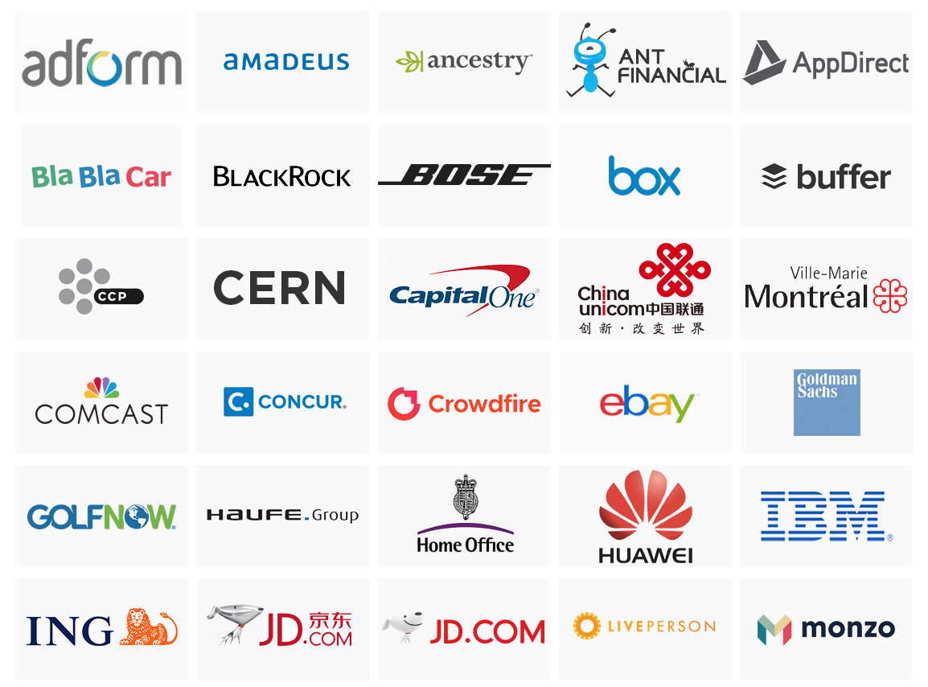
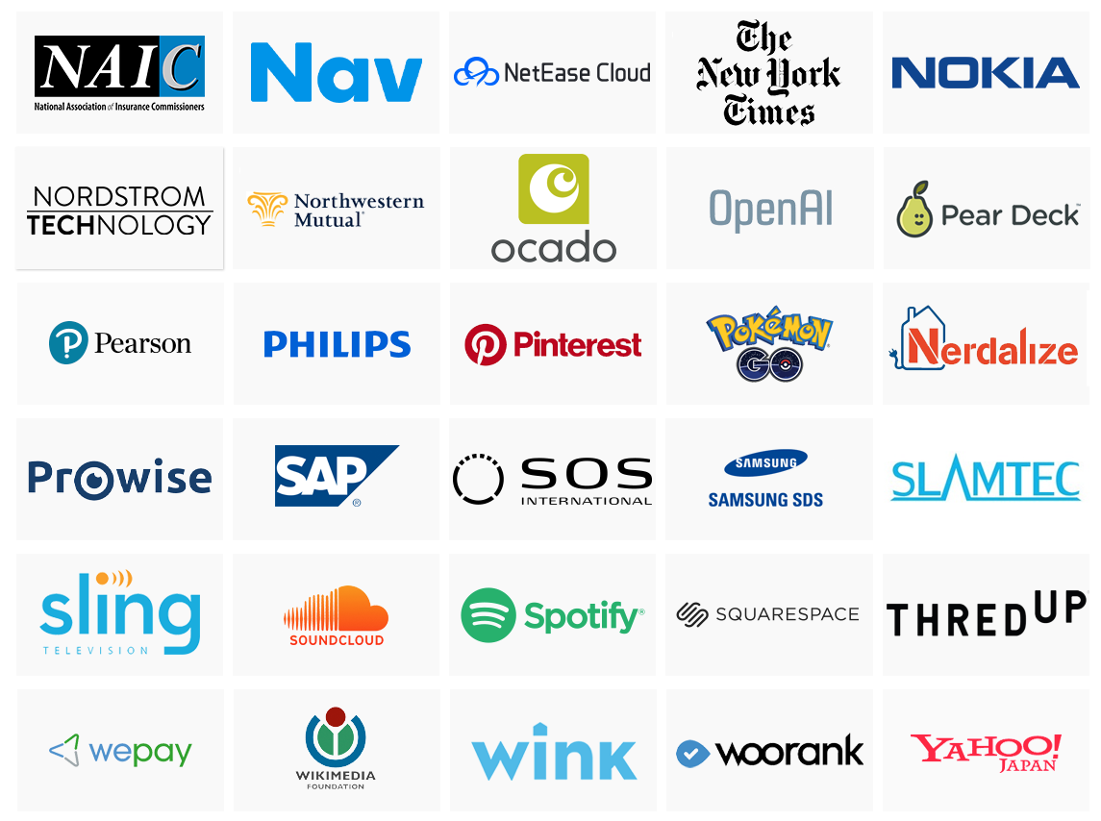
Image Source: kubernetes.io, accessed 20 June 2019

Slide 6
Configuration Management
Service Discovery
Load Balancing
Storage Orchestration
Healing
Scaling
Auto-Rollout
Image Source: kubernetes.io, accessed 20 June 2019

Slide 7
Image Source: https://blog.risingstack.com/what-is-kubernetes-how-to-get-started/, accessed 20 June 2019

Slide 8
Image Source: https://mapr.com/blog/kubernetes-kafka-event-sourcing-architecture-patterns-and-use-case-examples/, accessed 20 June 2019

Slide 9
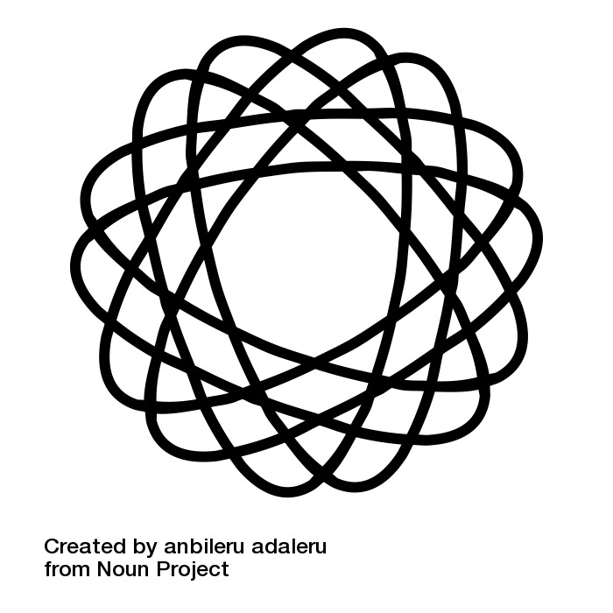
Complexity

Slide 10
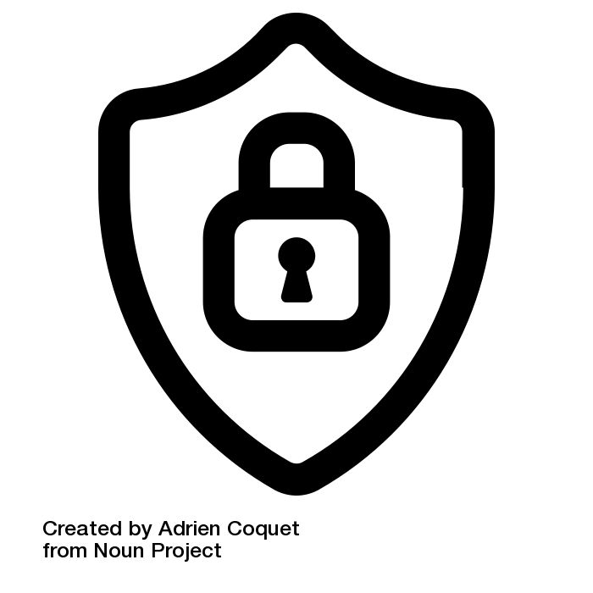
Complexity
→
Security?

Slide 11
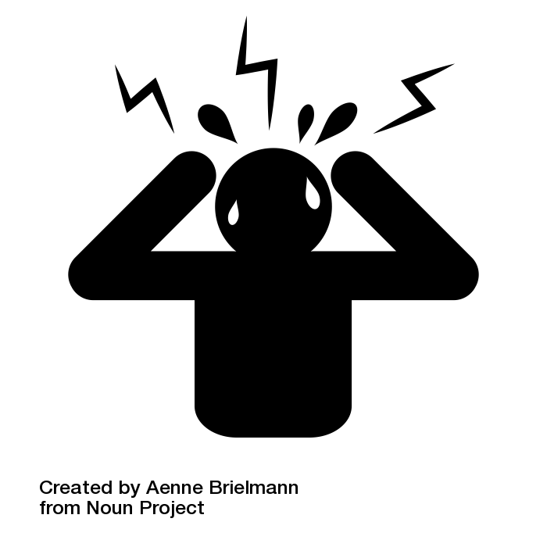
Kubernetes Security
Where to start?

Slide 12
Kubernetes Security

Slide 13
Kubernetes Security

Slide 14
Kubernetes Security

Slide 15
Kubernetes Security

Slide 16
Time for an example!

Slide 17
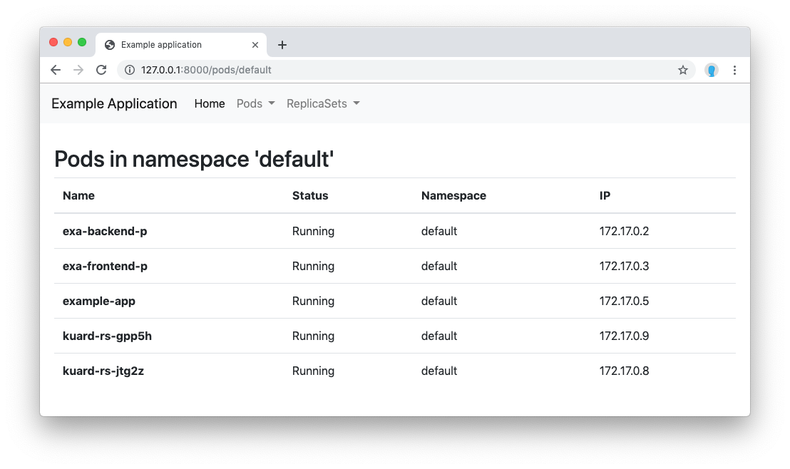

Slide 18
Security Aspects of Container Orchestration
Patrick Deutschmann, 28 June 2019

Slide 19
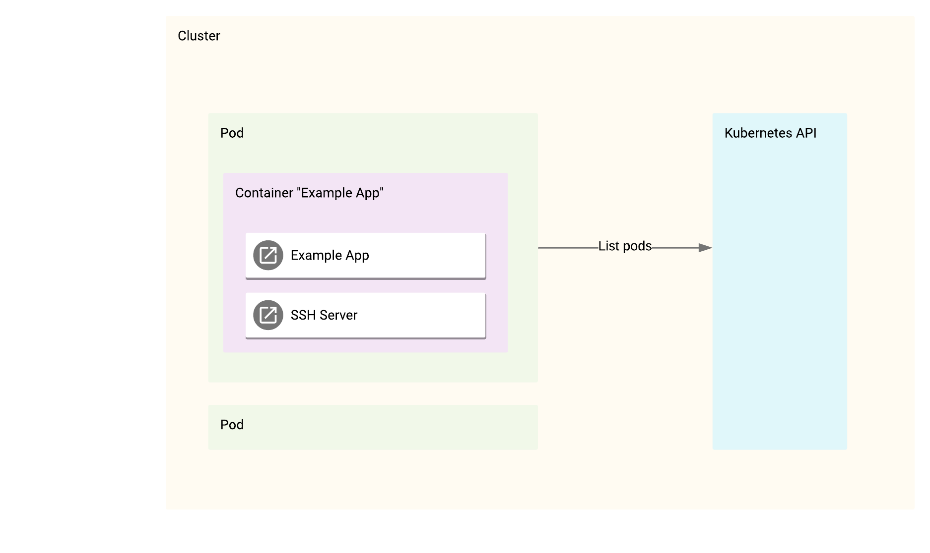

Slide 20
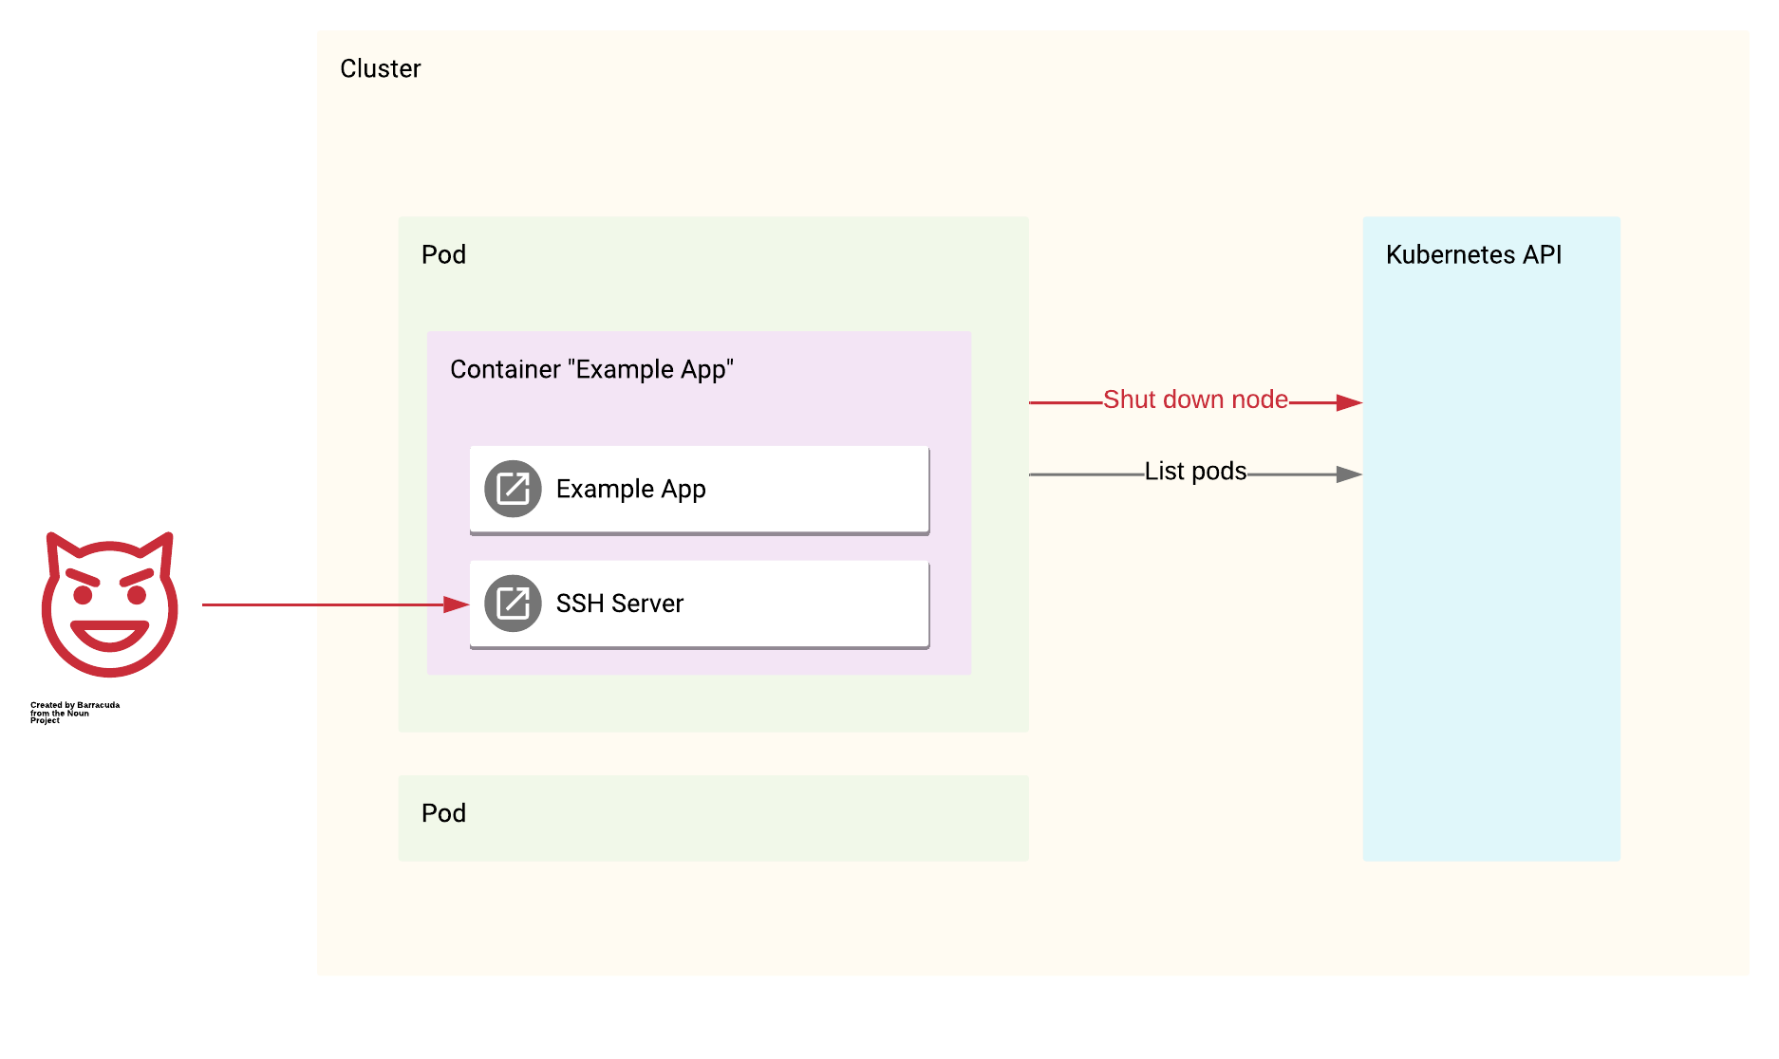

Slide 22


Slide 23
RBAC

Slide 24
CA?

Slide 26
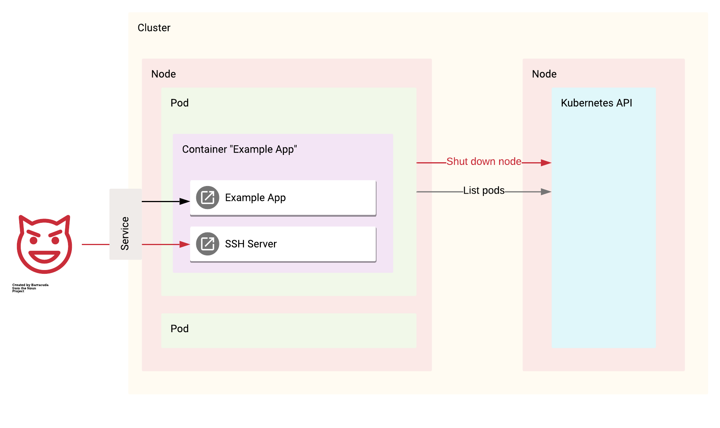

Slide 27
